Slide 1







Technology Skills Trend Analysis
Abdillahi Isse
Dec 17, 2021

Slide 2



OUTLINE
Executive Summary
Introduction
Methodology
Results
Visualization – Charts
Dashboard
Discussion
Findings & Implications
Conclusion
Appendix

Slide 3

EXECUTIVE SUMMARY
Current Technology Skills Trend
Language
Database
Platform
Web frame
Future Technology Skills Trend
Language
Database
Platform
Web frame
Demographic Differences
Gender Differences

Slide 4

INTRODUCTION
Analyzing technology skills trend in software and database languages and web development among developers around the world
Recognize the top programming languages, database, platform and web frame skills in demand
Recognize skill requirements for future
Recognize Human resource differences in the tech industry.

Slide 5

METHODOLOGY
Data Gathering – Sources
Stack overflow developer 2019 survey
GitHub job postings
Programming languages annual salary
Data Wrangling
Data Exploration
Data Cleaning
Data Visualization
Python matplotlib
IBM Cognos

Slide 6
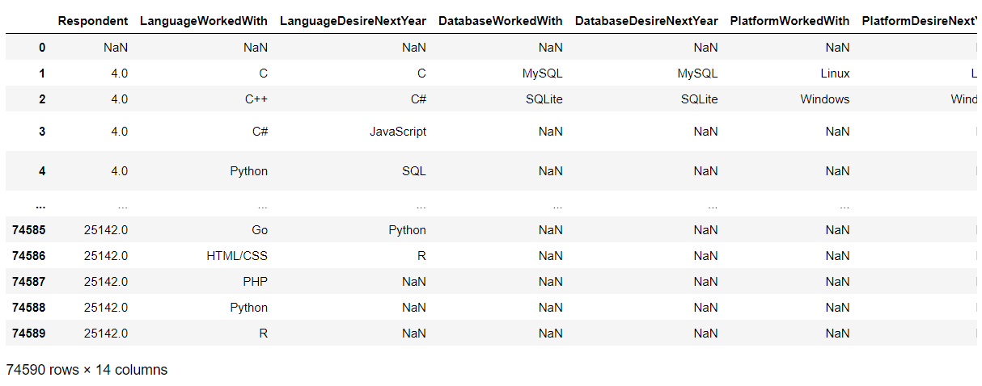
RESULTS

Slide 7
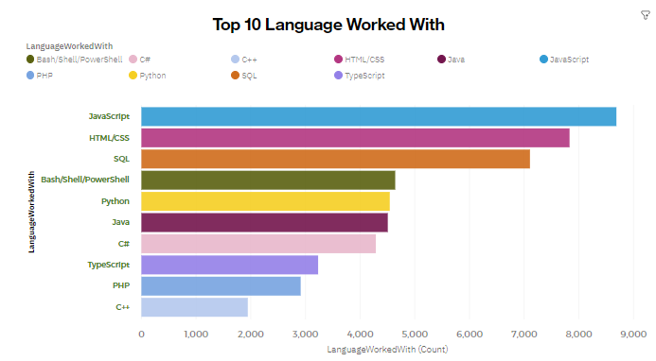
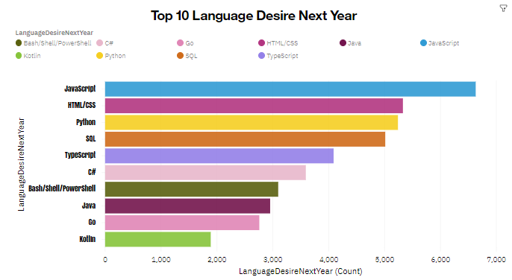
PROGRAMMING LANGUAGE TRENDS
Current Year
Next Year

Slide 8
PROGRAMMING LANGUAGE TRENDS - FINDINGS & IMPLICATIONS
Findings
JavaScript and HTML & CSS are top trending languages in the world
Python and TypeScript are the languages of the future.
SQL still demandable and highly used.
Implications
Java & C++ are not that demandable in the future as they used to be.
Python Can be number 1 Programing language in couple of years for its flexibility and simplicity
JavaScript is still going to be 1st language for the web developers.

Slide 9
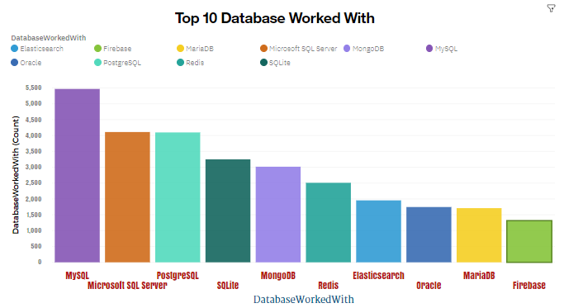
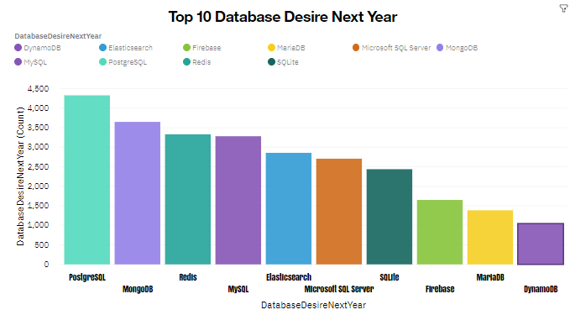
DATABASE TRENDS
Current Year
Next Year

Slide 10
DATABASE TRENDS - FINDINGS & IMPLICATIONS
Findings
MySQL is still the favorite Database in use
Microsoft SQL Server is still popular in the tech industry.
Implications
PostgreSQL is the future favorite database alongside MangoDB and Redis
MySQL and Sqlite demand is decreasing in the future
Elasticsearch and Firebase demand in the tech industry is going to increase.

Slide 11

DASHBOARD
https://eu-gb.dataplatform.cloud.ibm.com/dashboards/cca2d25c-b6f5-45a9-8684-c6712b6a2aa9/view/6e63f93931891dd554c1eae4079e7e027d63770be6bb8b5788857b490d342097a86f47c5c8284b0edf160161f6e8135e9b

Slide 12
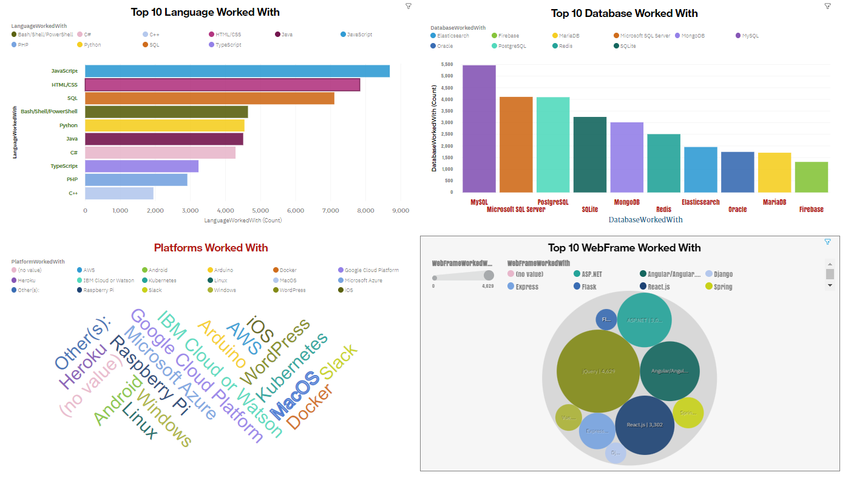
DASHBOARD TAB 1

Slide 13
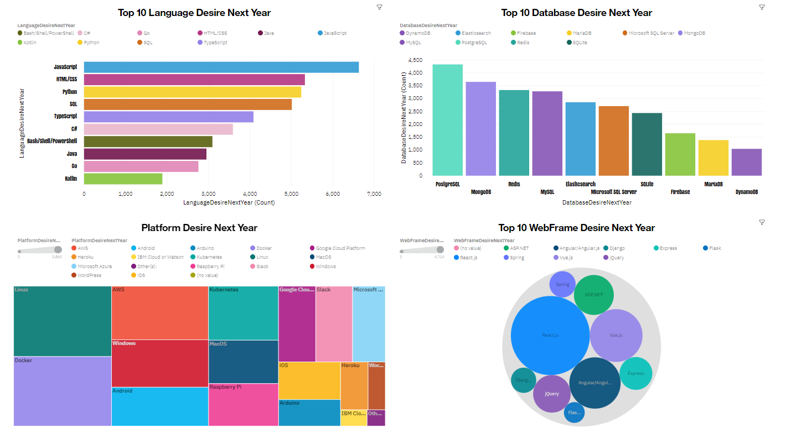
DASHBOARD TAB 2

Slide 14
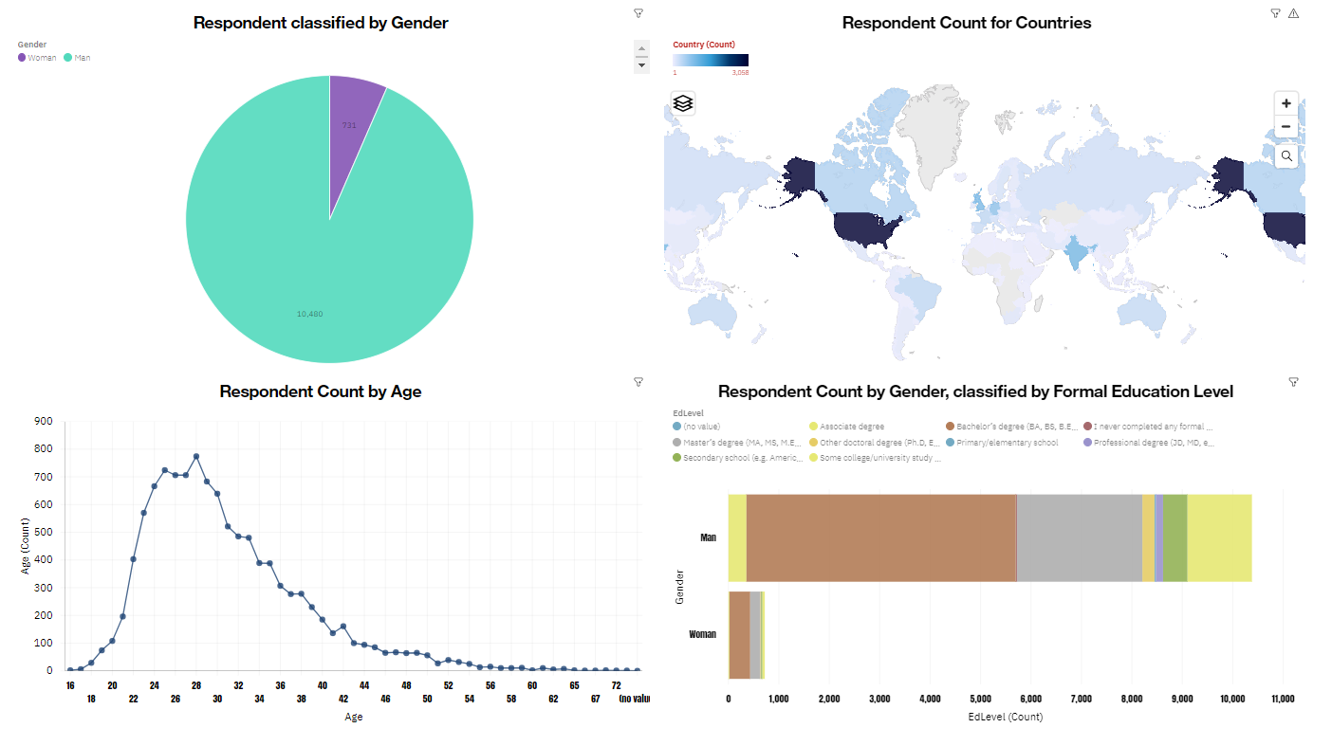
DASHBOARD TAB 3

Slide 15
DISCUSSION
Technology Skills Trend Present and the Future
Gender, Age and Education Gaps in IT Industry

Slide 16
OVERALL FINDINGS & IMPLICATIONS
Findings
Technology demanded skills is going to change big in the next 3 years.
There are extreme gap in gender and age in the tech industry.
Reactjs and Vuejs are the most popular Web Frame.
Implications
The gap between gender in the industry should change rapidly.
Age shouldn't be a concern when hiring in the tech industry as it is now.

Slide 17

CONCLUSION
Technology Skills Trends.
Programming Languages, Database, Platform and Web frame Trends.
Gender, Age and Education.
Demographics Trends.
Programming Languages and Salary Trends.

Slide 18
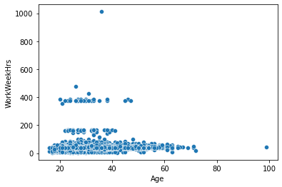

APPENDIX

Slide 19
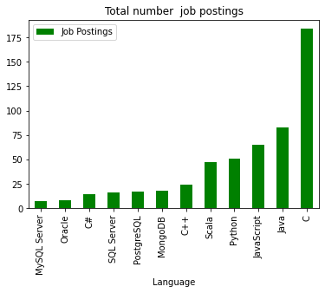
GITHUB JOB POSTINGS - Descending

Slide 20
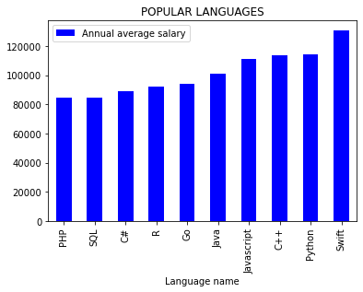
POPULAR LANGUAGES - Descending

